Slide 1

Poetry recitation contest 2025. Guidelines for teachers
By Diana Bolgare
Freelance
Riga, Latvia
2025

Slide 2
WHAT?
Poetry recitation contest

Slide 3
WHY?
Poems are short
A dynamic way to introduce students to poetry
Easy to implement
Inspires learning

Slide 4
WHEN?
2025/26 School year Online phase from September until October 30, 2025
Offline Finals 30 November 2025, Theatre Museum, Ed.Smilga 37 Riga, Latvia

Slide 5
HOW?
A teacher makes Poetry in My Heart optional to all their students to receive extra credit.
Actual work on the poem
A student records a poem and submits the link to the file with their reading via the Google Form until 30 October https://forms.gle/abLL3H4u8muTQRDg8
The form is to be submitted by a parent or guardian.
The winners of the online phase move on to the next level of the competition – offline finals.
The winner of the offline finals receives a valuable prize (to be discussed and confirmed).

Slide 6
Let’s start
1. Explore the poems
https://www.poetryoutloud.org/search/?type=poem
https://www.poetrybyheart.org.uk/poems
https://poets.org
any other source available

Slide 7
Let’s start
2. Discuss the chosen poem.
3. Help students memorize the poem.
4. Record the poem.
5. Send the link via Google Form https://forms.gle/oC4Pf7x3413VKSSw7
6. The form is to be submitted by a parent or guardian.

Slide 8
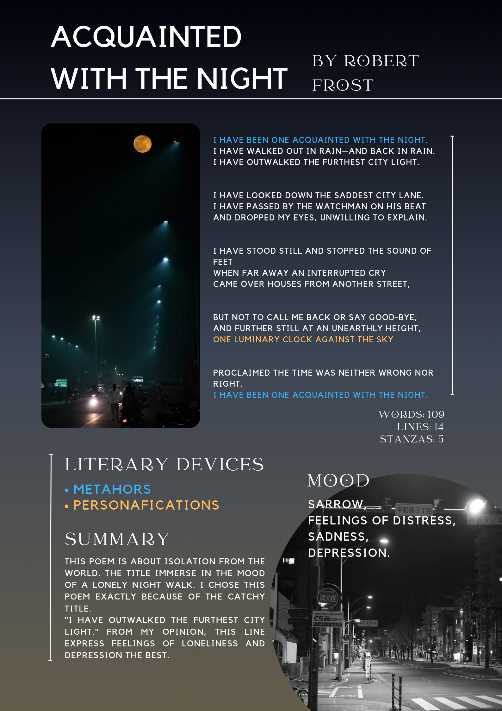
How to work on the poem?
Level 1
Text Analysis:
Summary
Literary Devices
Mood
Why?
Hidden message
Illustration, word count, title, author, the poem itself
Lesson Plan 29: Poetry assignment (Lesson Plans_Literature in a Foreign Language Class_Tiltina.pdf) “LITERATURE IN A FOREIGN LANGUAGE CLASS” A collection of ideas inspired by Erasmus+ cooperation partnerships in school education

Slide 9
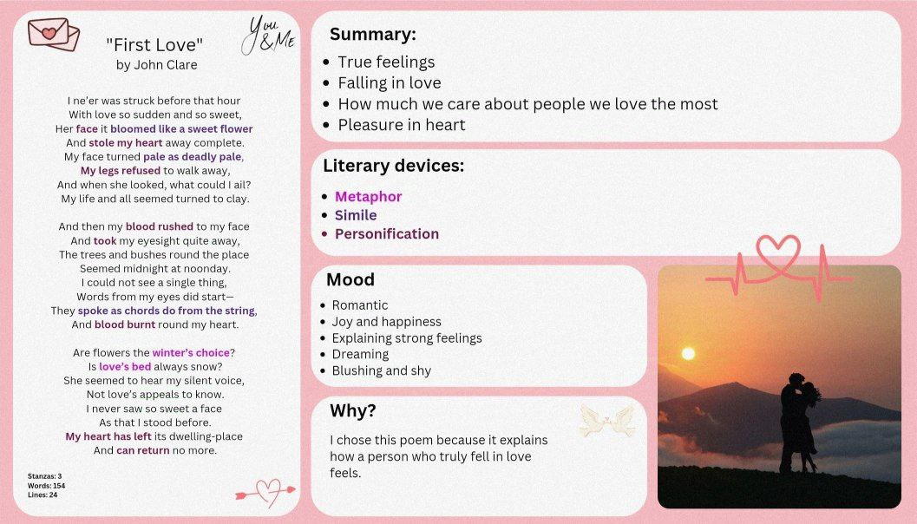

Slide 10
How to work on the poem?
Level 2
Vocal production:
relaxation, breathing,
resonance and voice projection
Exercises, vocal warm-ups

Slide 11
How to work on the poem?
Level 3
Performance:
Intonation, stress, rhythm, pauses
Body language (Gestures)
Facial expressions

Slide 12
Let’s continue
7. Offline Finals (30.11.2025 – a 2-hour day-time event 12:00 – 14:00 in Riga)
8. Reciting a new poem
9. Creative writing (for 15-18 y.o. students)
10. Presenting creative writing
11. Choosing the winner

Slide 13
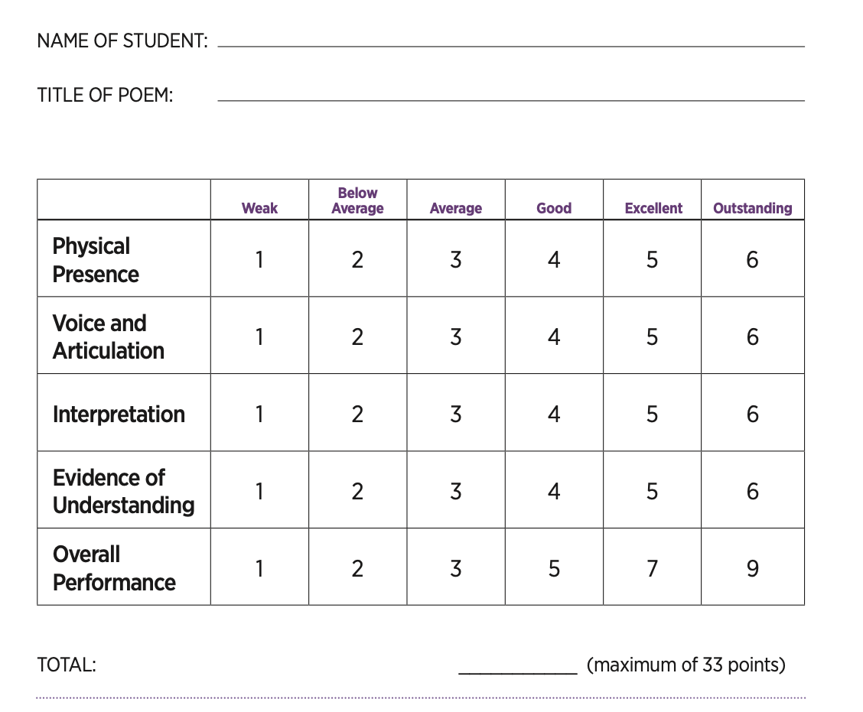
Judging and scoring
Poetry Out Loud evaluation sheet
2 judges

Slide 14
Rules:
Memorization: Students must recite their poems from memory.
Props: Students may not use props or wear costumes during their recitations.

Slide 15
Judges’ advice
Nadezhda Pikuleva:
”I would advise thinking through gestures and glances while learning the poem right from the start.
Choose a poem that aligns with the student's nature so that both the student and the poem feel comfortable, natural, and clear together.
Approach the competition as a game, an experience. Challenge yourself with questions like, "What can I do differently here than I usually do? How can I make this easy?"

Slide 16
Judges’ advice
Ilona Buckmaster:
If possible, learn the poem in advance. Tell it to your class, to someone else, somewhere else. This reduces the stress of public speaking and gives you the opportunity to devote yourself more to sincerity and expression.
The main thing is to feel like not a person who is being evaluated. But a person who came to share his reading.

Slide 17
Rules for recording a poem
Vertical Instagram format.
Filming on a phone.
The background should be either aesthetic or plain.
Learn the lines by heart - Don’t read.
The shot should be framed from the waist up or shoulders up.
Clothing should be in calm colors.

Slide 18
Creative Writing for 15-18-year-olds
Practise creative writing exercises

Slide 19
Creative Writing
N + v + adverb
Preposition + pronoun. Pronoun.?!
Poetry Frames
Wizards are here.
Among us. You?

Slide 20
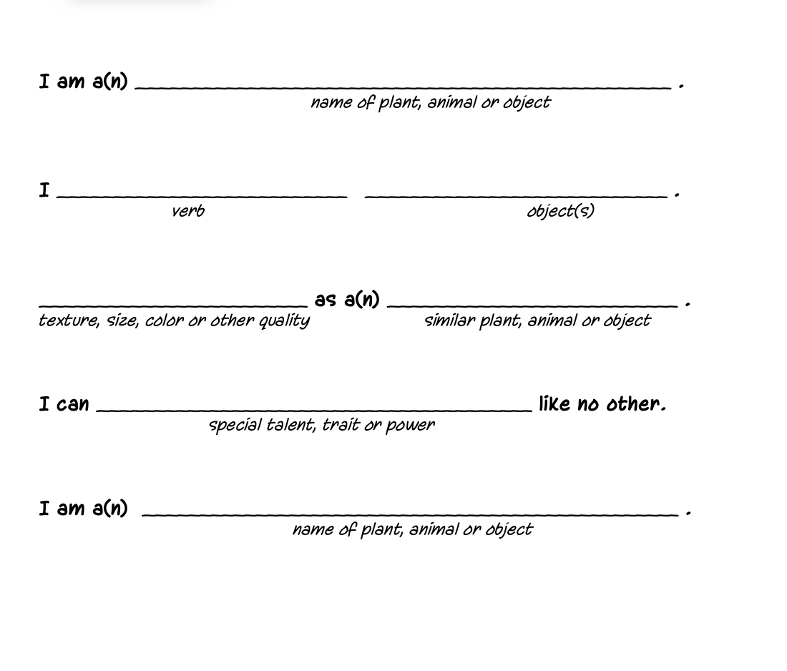
Creative Writing
an “I am” poem
I am a(n) (name of plant, animal, or object).
I (verb) (object).
(Texture, size, color, or other quality) as a (similar plant, animal, or object).
I can (special talent, trait, or power) like no other.
I am a(n) (name of plant, animal, or object).

Slide 21
Creative Writing
Noun
Adj Adj
Gerund Gerund Gerund
Phrase
Synonym
Diamond Poems

Slide 22
Creative Writing
A Step
Quiet, Difficult
Making-to-believe
Starting and ending
But which never ends
A culture, not a history
A chance
Diamond Poems
Example from Poetry in My Heart 2024
Topic – Poetry
https://vimeo.com/1050263284?share=copy

Slide 23
Creative Writing
Human
Creative, Passionate
Thinking, Fighting, Surviving
The creation of God
Mortal
Diamond Poems
Example from Poetry in My Heart 2024
Topic – Poetry
https://vimeo.com/1050263183

Slide 24
Creative Writing
Pain
Slow, Hurtful
Crushing, Shattering, Scaring
Never again
Hurt
Diamond Poems
Example from Poetry in My Heart 2024
Topic – Poetry
https://vimeo.com/1050263468

Slide 25
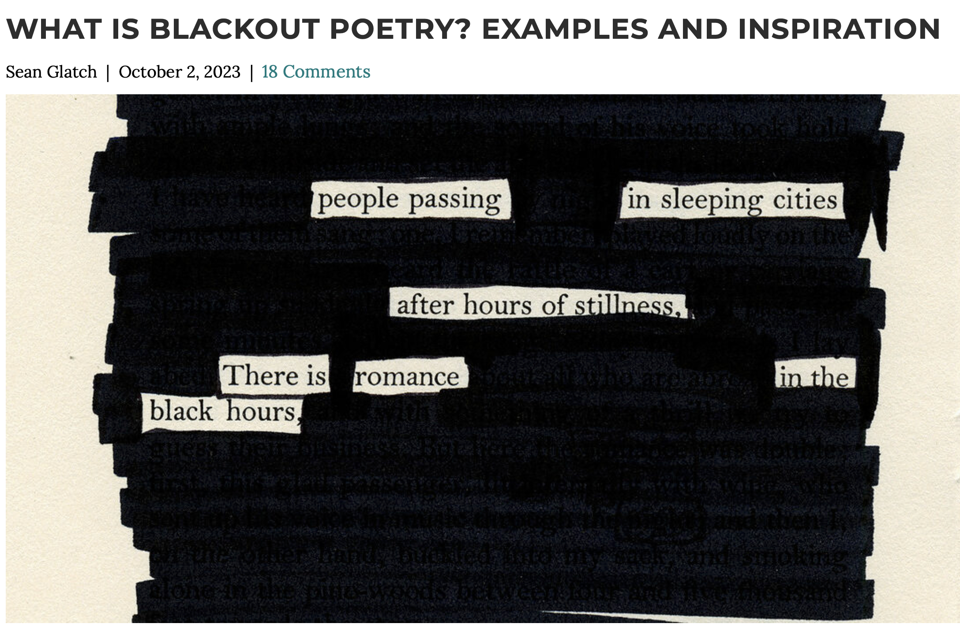
Creative Writing
Blackout Poetry

Slide 26
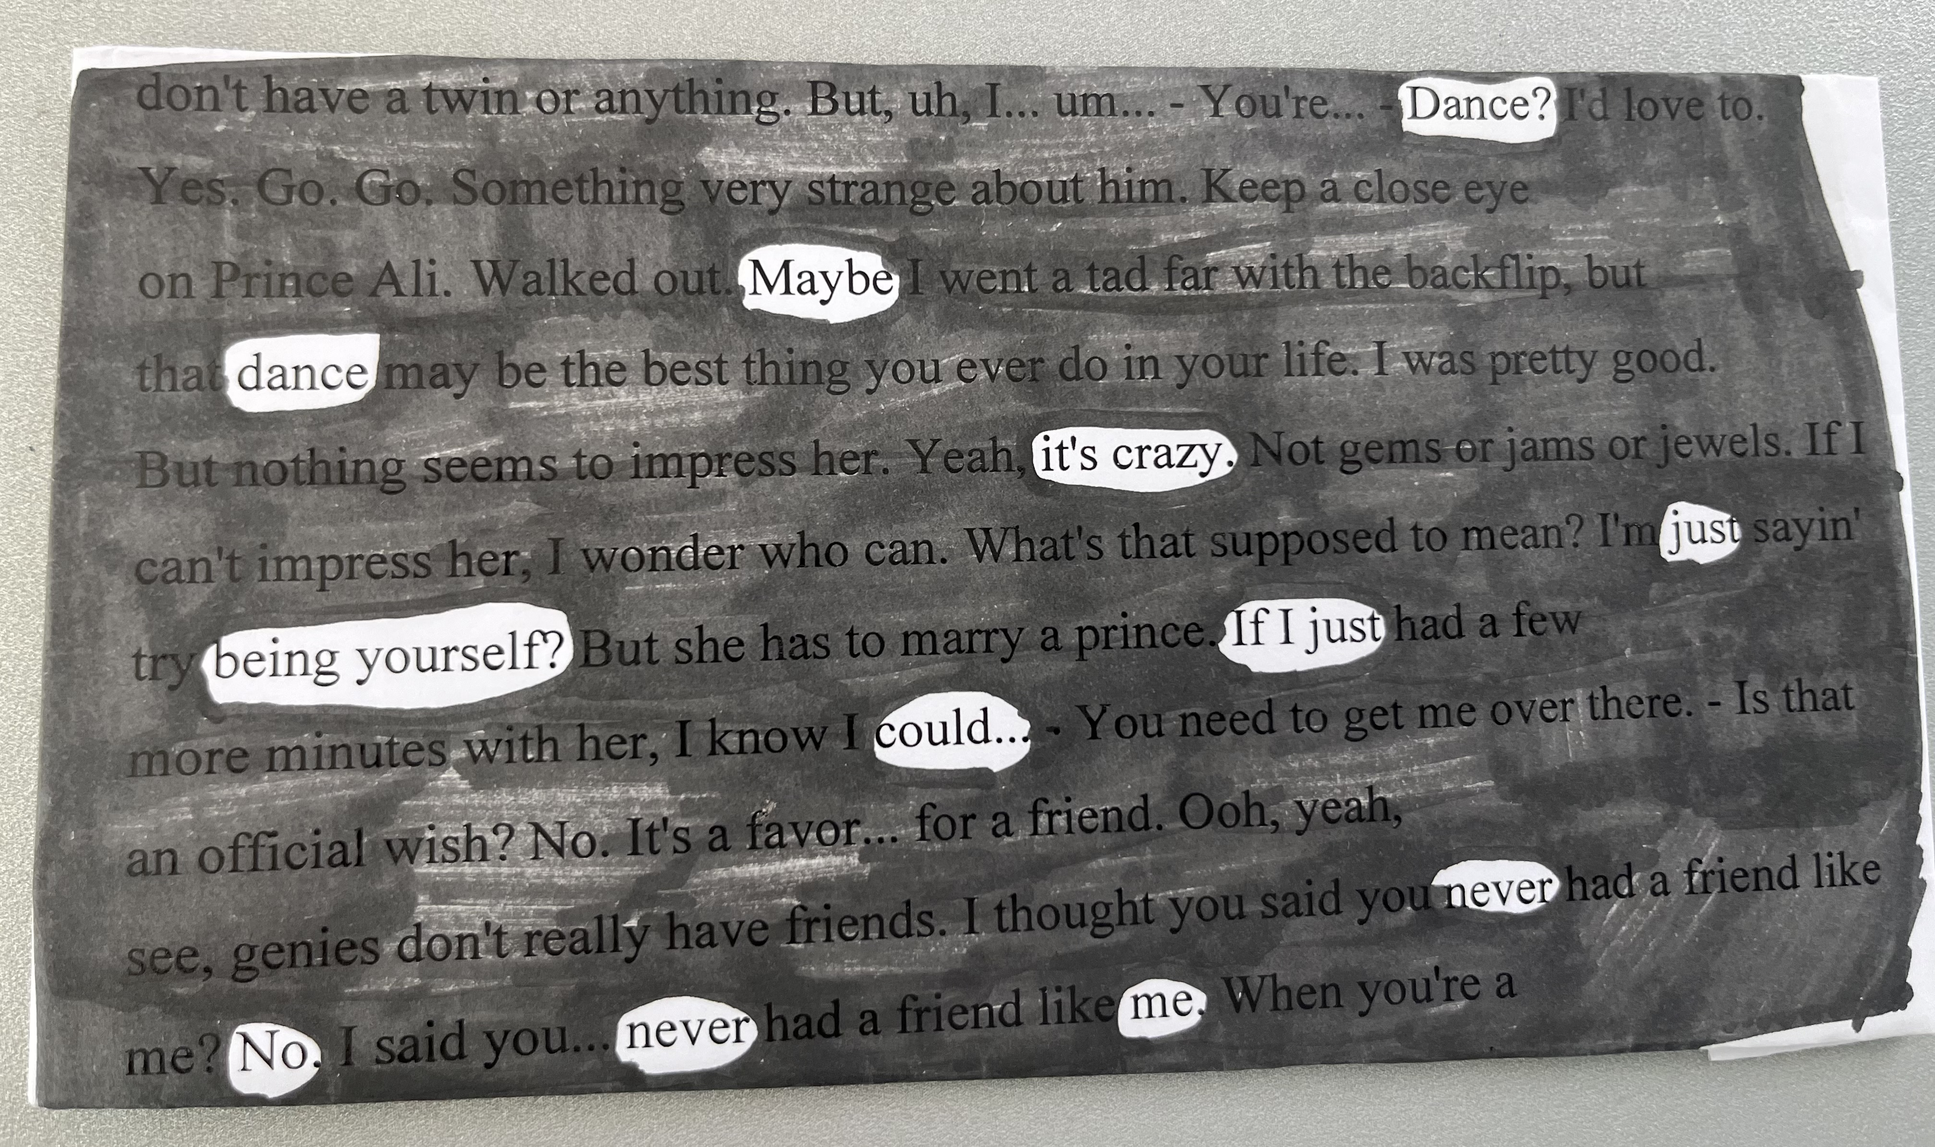
Creative Writing
Blackout Poetry
Example from Poetry in My Heart 2024
https://vimeo.com/1050263122

Slide 27
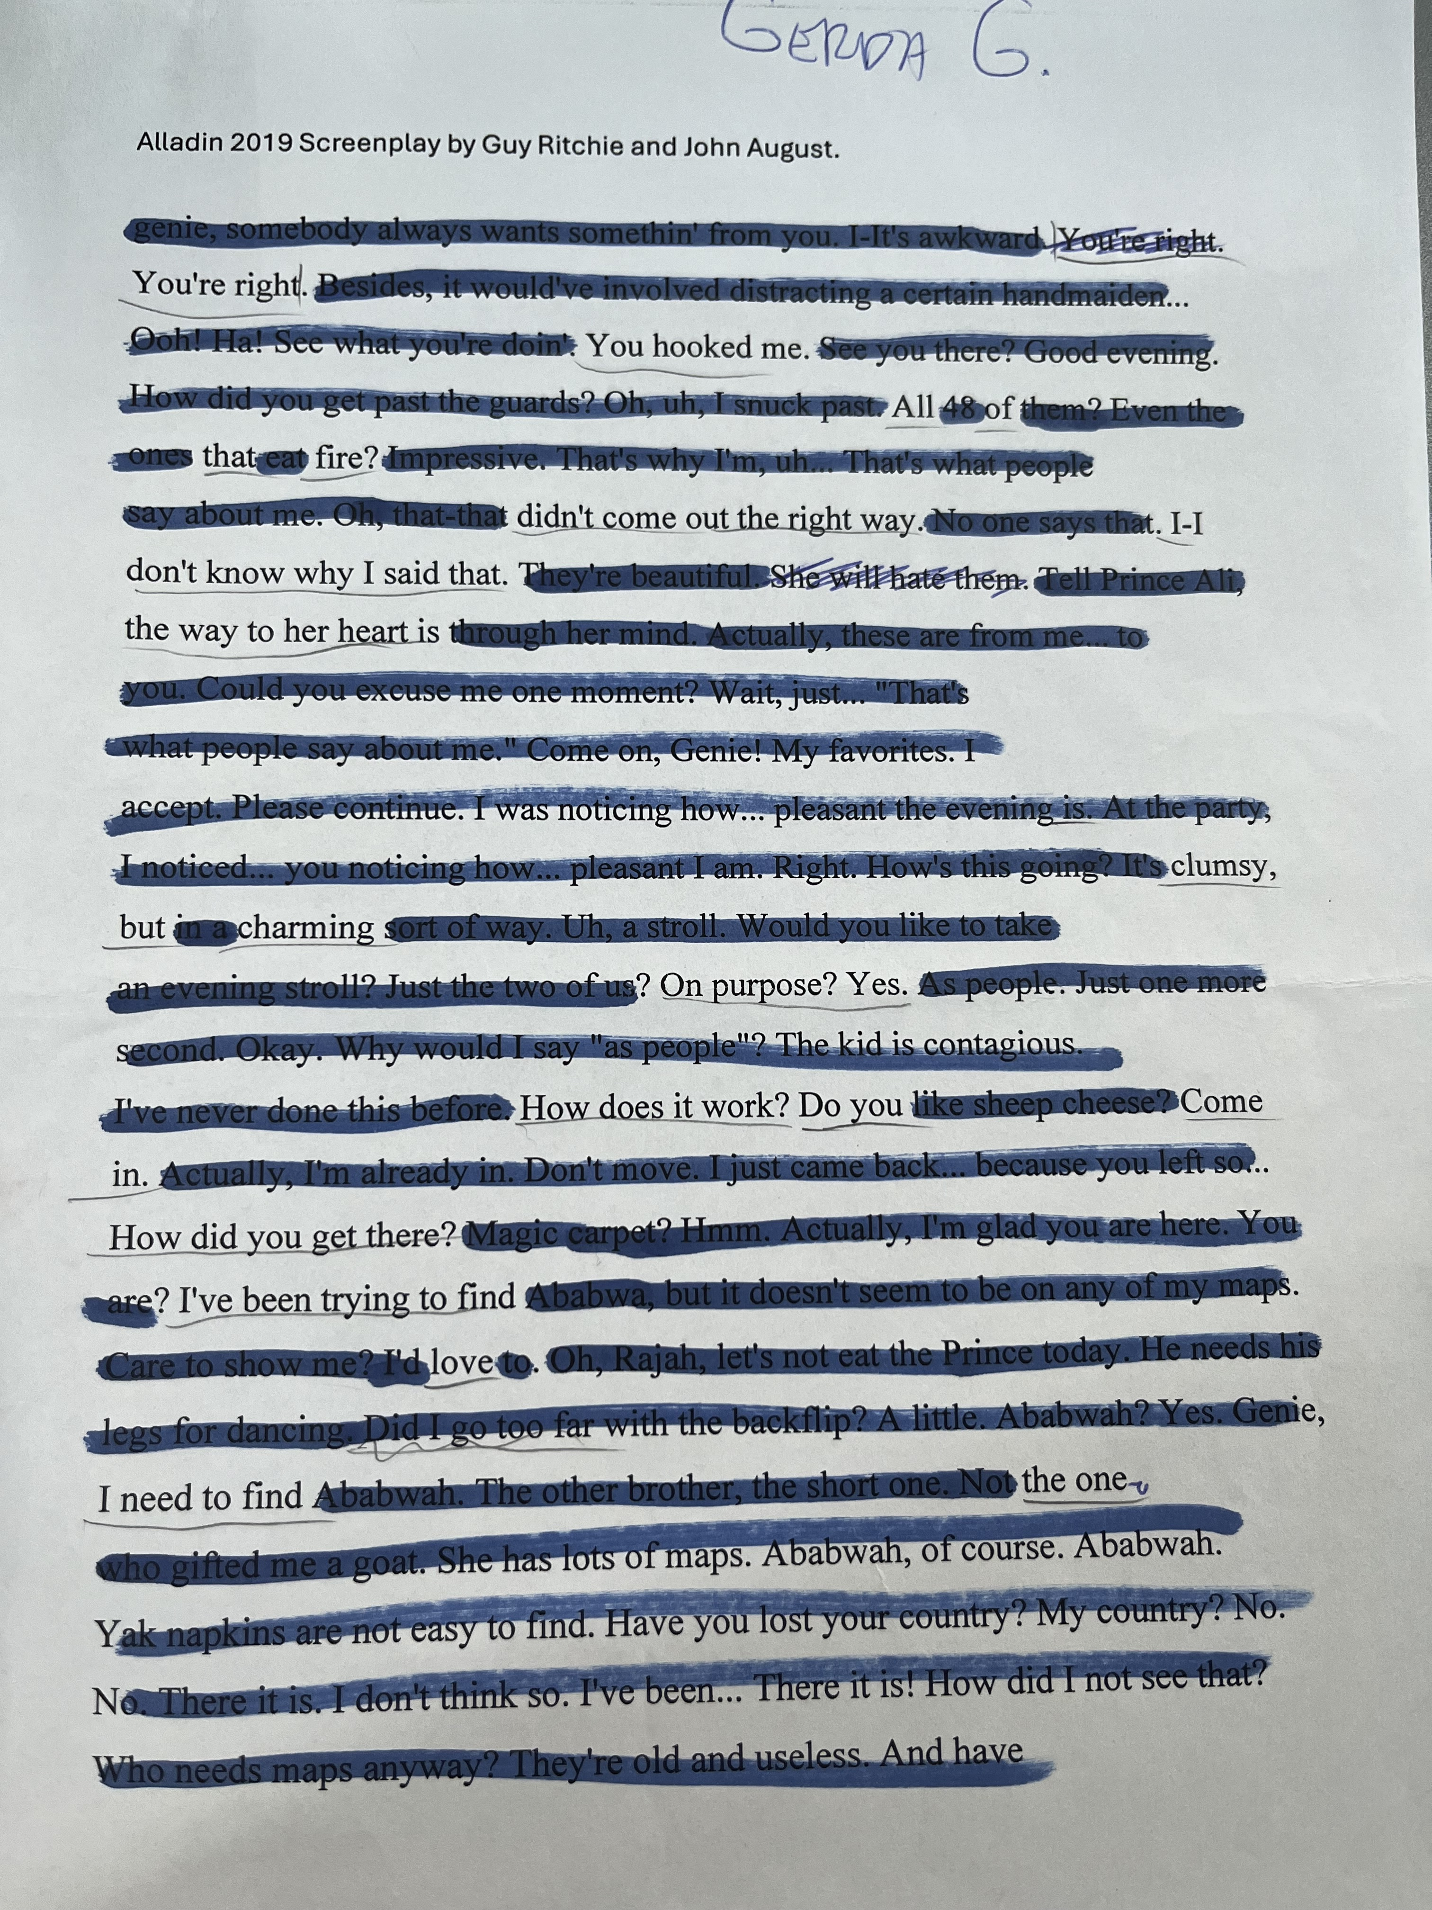
Creative Writing
Blackout Poetry
Example from Poetry in My Heart 2024
https://vimeo.com/1050263409

Slide 28
Creative Writing
Distinguished
Aspiring
Venturesome
Interesting
Debonair
Name Acronym

Slide 29
Any other forms of creative Writing?

Slide 30
Thank you for your attention.
Any questions?

Slide 31
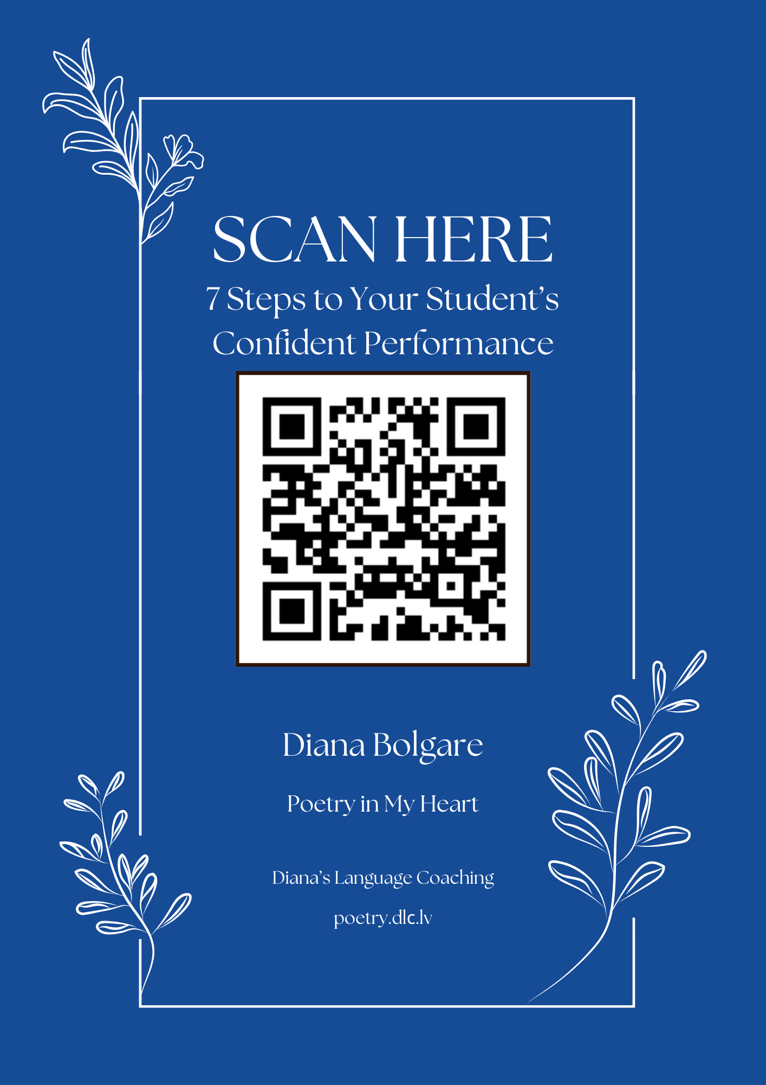
Diana Bolgare
(371 22300743 sms)
Poetry in My Heart♥️ 2025
https://poetry.dlc.lv
To join the Telegram group of teachers-participants https://t.me/+rjFtzTTkXIA5YTA0

